Slide 1
cs5460/6460: Operating Systems Lecture: Interrupts and Exceptions
Anton Burtsev
March, 2024

Slide 2
1317 main(void)
1318 {
1319 kinit1(end, P2V(4*1024*1024)); // phys page allocator
1320 kvmalloc(); // kernel page table
1321 mpinit(); // detect other processors
1322 lapicinit(); // interrupt controller
1323 seginit(); // segment descriptors
1324 cprintf("\ncpu%d: starting xv6\n\n", cpunum());
1325 picinit(); // another interrupt controller
1326 ioapicinit(); // another interrupt controller
1327 consoleinit(); // console hardware
1328 uartinit(); // serial port
1329 pinit(); // process table
1330 tvinit(); // trap vectors
1331 binit(); // buffer cache
1332 fileinit(); // file table
1333 ideinit(); // disk
1334 if(!ismp)
1335 timerinit(); // uniprocessor timer
1336 startothers(); // start other processors
1337 kinit2(P2V(4*1024*1024), P2V(PHYSTOP)); // must come after startothers()
1338 userinit(); // first user process
1339 mpmain(); // finish this processor’s setup
1340 }
main()

Slide 3
Why do we need interrupts?
Remember:
hardware interface is designed to help OS

Slide 4
Why do we need interrupts?
Two main use cases:
[Synchronous] Something bad happened and OS needs to fix it
Program tries to access an unmapped page (OS maps the page if its on disk)
[Asynchronous] Notifications from external devices
Network packet arrived (OS will copy the packet from temporary buffer in memory (to avoid overflowing) and may switch to a process waiting on that packet)
Timer interrupt (OS may switch to another process)
A third, special, use-case
[It's also synchronous] For many years an interrupt, e.g., int 0x80 instruction, was used as a mechanism to transfer control flow from user-level to kernel in a secure manner
In other words, to implement system calls
Now, a faster mechanism is available (sysenter)

Slide 5
How do we handle an interrupt?

Slide 6
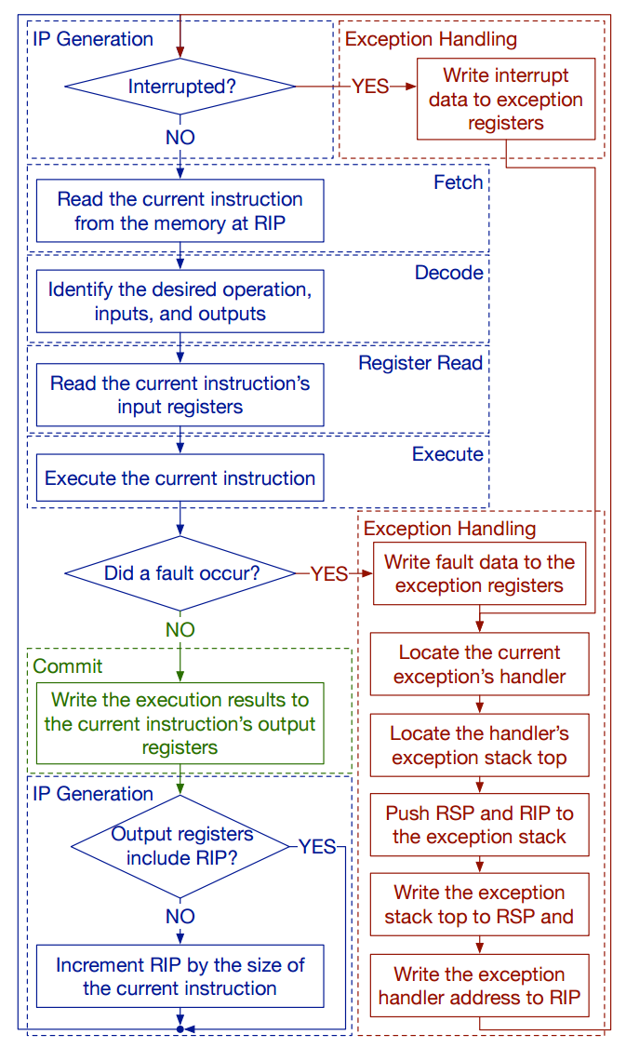
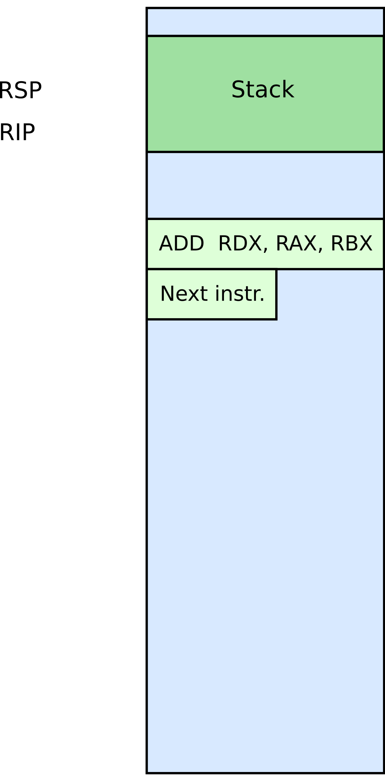

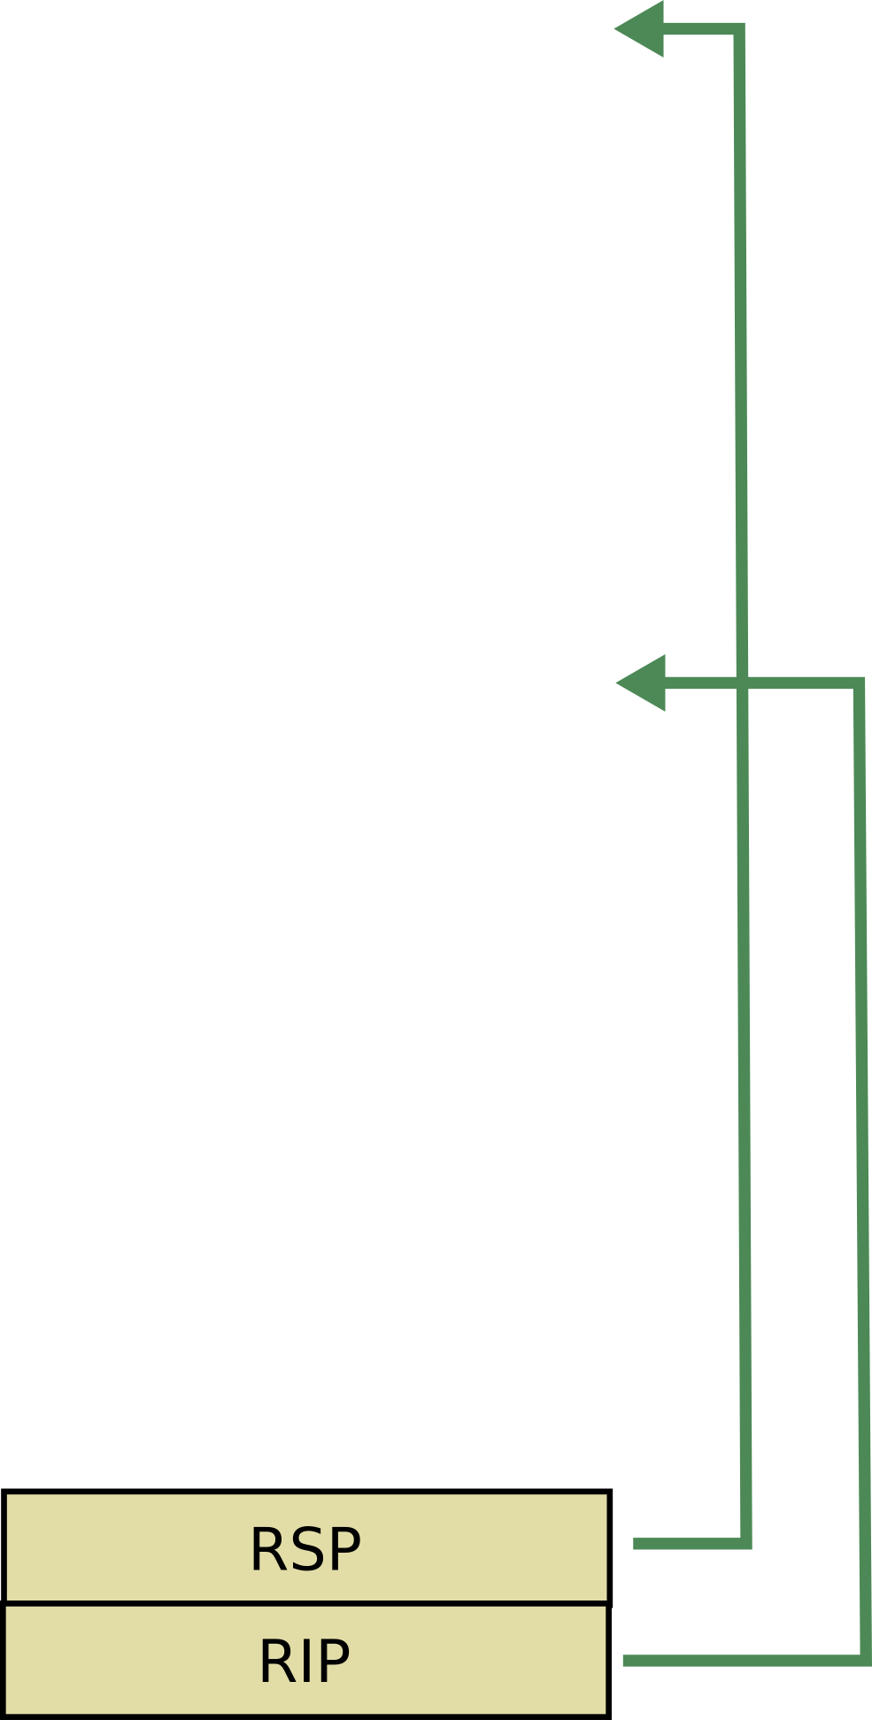




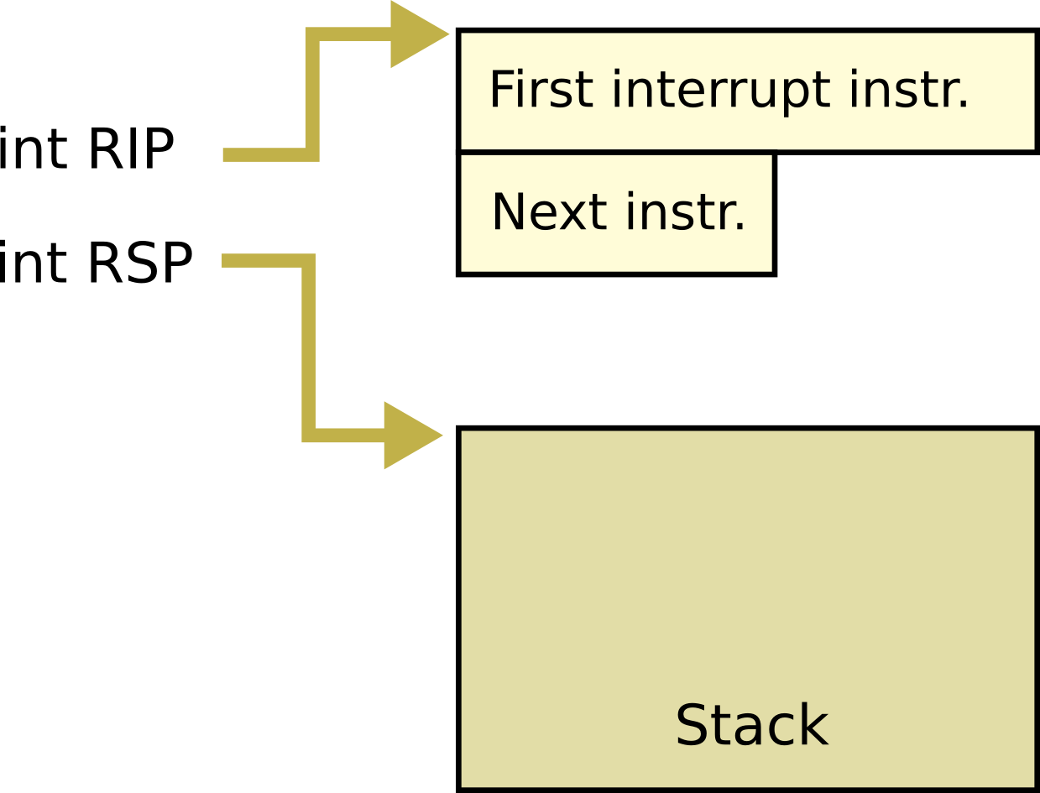

Slide 7
Handling interrupts and exceptions
In both synchronous and asynchronous cases the CPU follows the same procedure
Stop execution of the current program
Start execution of a handler
Processor accesses the handler through an entry in the Interrupt Descriptor Table (IDT)
Each interrupt is defined by a number
E.g., 14 is pagefault, 3 debug
This number is an index into the interrupt table (IDT)

Slide 8
There might be two cases
Interrupt requires no change of privilege level
i.e., the CPU runs kernel code (privilege level 0) when a timer interrupt arrives, or kernel tries to access an unmapped page
Interrupt changes privilege level
i.e., the CPU runs user code (privilege level 3) when a timer interrupt arrives, or
user code tries to access an unmapped page

Slide 9
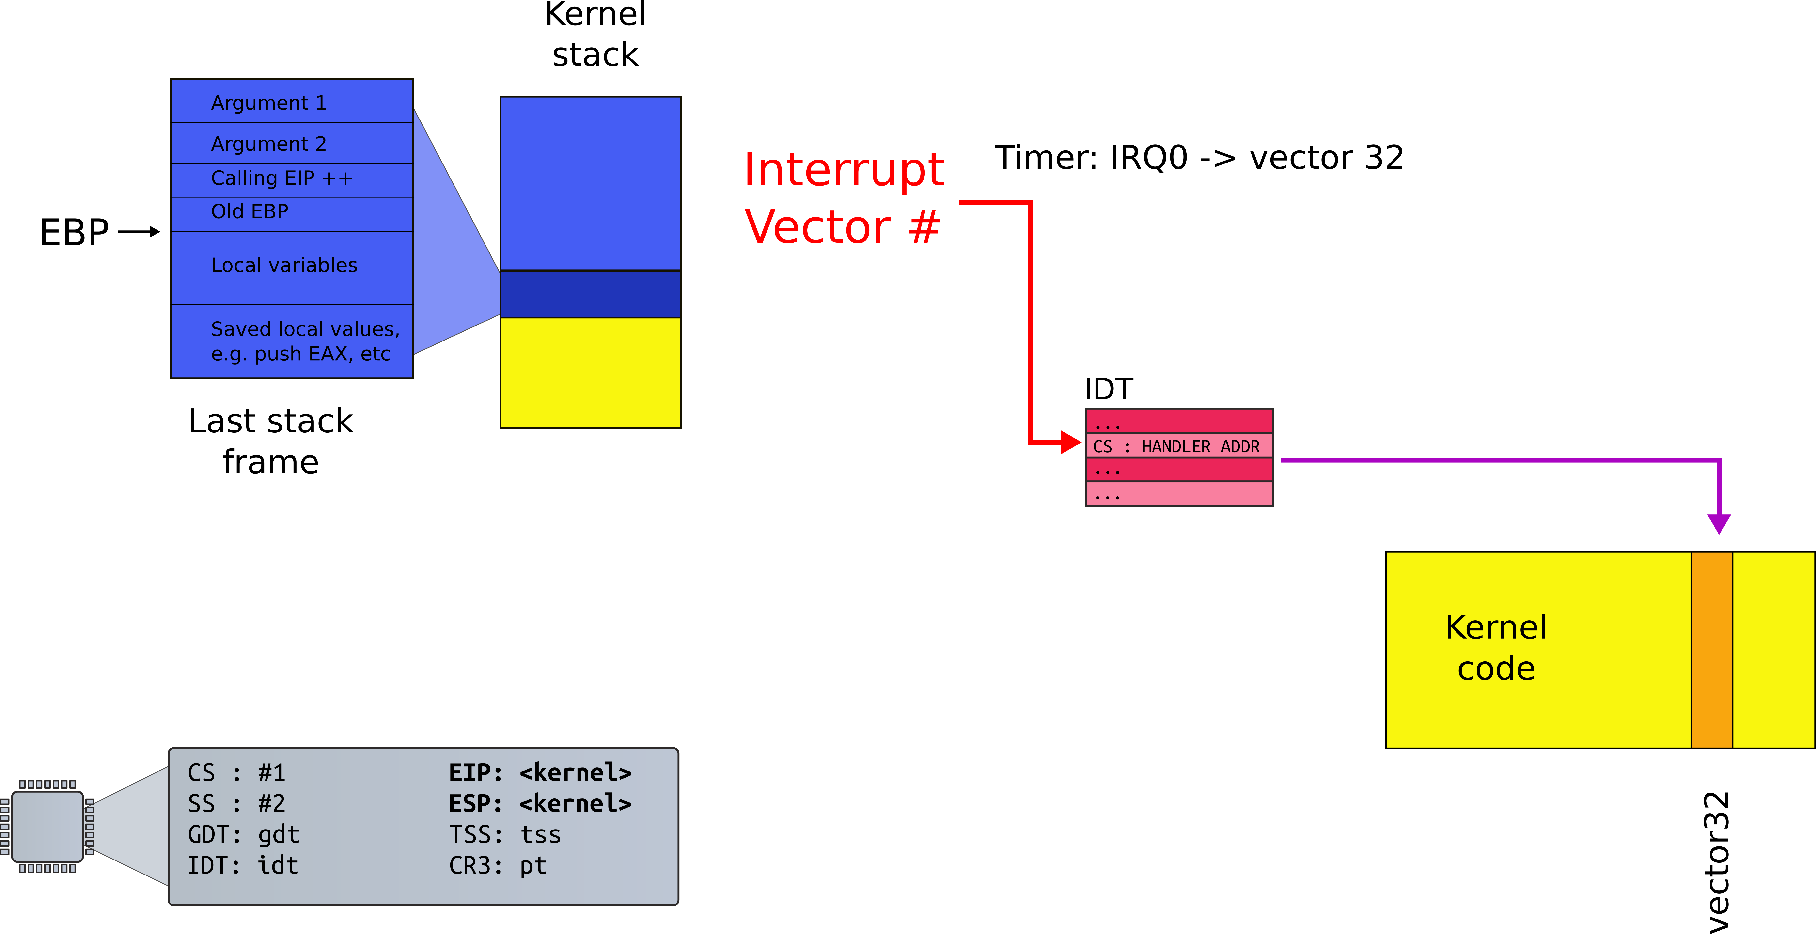
Case #1: Interrupt path no change in privilege level
e.g., we're already running in the kernel

Slide 10
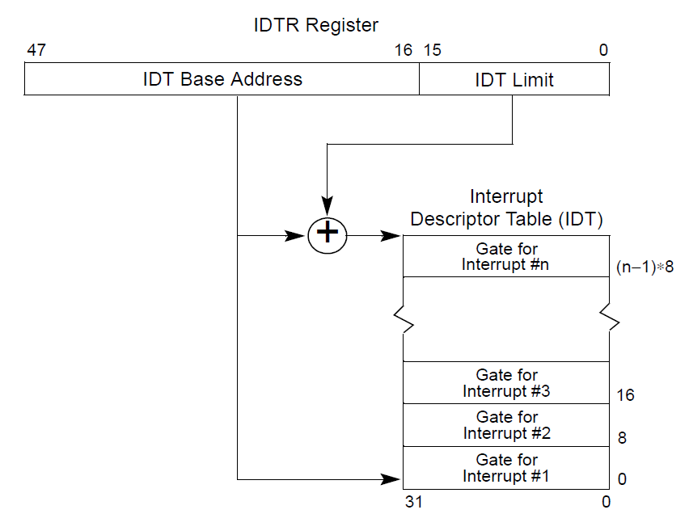
Interrupt descriptor table (IDT)
Is pointed by the IDTR register
Virtual address
OS configures the value and loads it into the register (normally during boot)

Slide 11
CPU
CPU
Memory

Slide 12
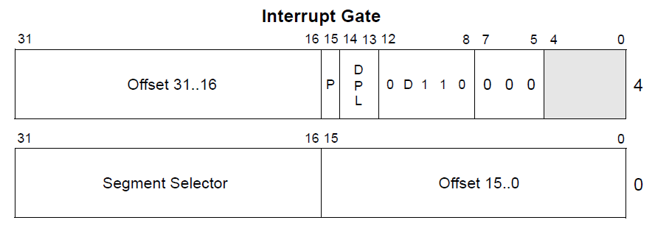
Interrupt descriptor

Slide 13
Interrupt descriptor
We will walk through these fields gradually
For now, we care about vector offset
Pointer to the interrupt handler

Slide 14
Interrupt handlers
Just plain old code in the kernel
The IDT stores a pointer to the right handler routine

Slide 15
Interrupt path

Slide 16
Processing of interrupt (same PL)
Push the current contents of the EFLAGS, CS, and EIP registers (in that order) on the stack
Push an error code (if appropriate) on the stack
Load the segment selector for the new code segment and the new instruction pointer (from the interrupt gate or trap gate) into the CS and EIP registers
If the call is through an interrupt gate, clear the IF flag in the EFLAGS register (disable further interrupts)
Begin execution of the handler

Slide 17
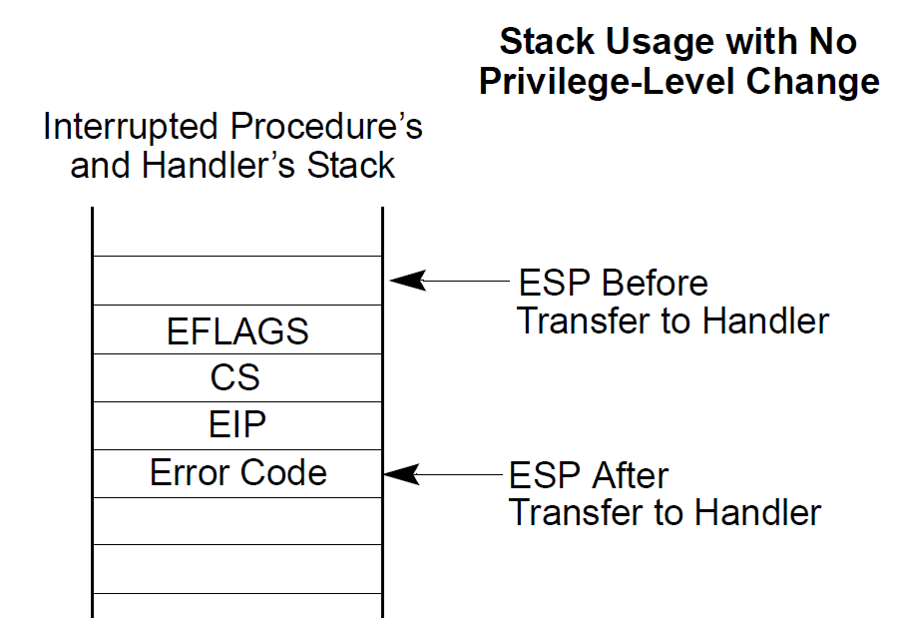

Slide 18
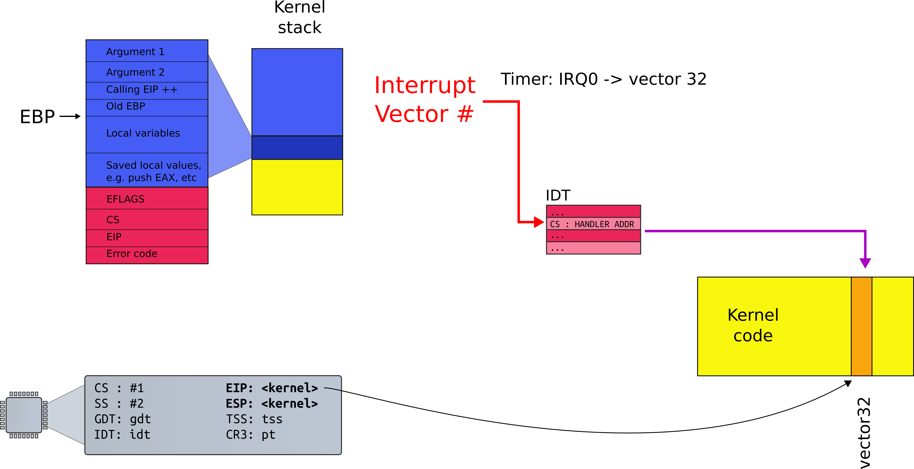
Interrupt path

Slide 19
Return from an interrupt
Starts with IRET
Restore the CS and EIP registers to their values prior to the interrupt or exception
Restore EFLAGS
Restore SS and ESP to their values prior to interrupt
This results in a stack switch
Resume execution of interrupted procedure

Slide 20
Processing of interrupt (cross PL)
Need to change privilege level...

Slide 21
Detour:
What are those privilege levels?

Slide 22
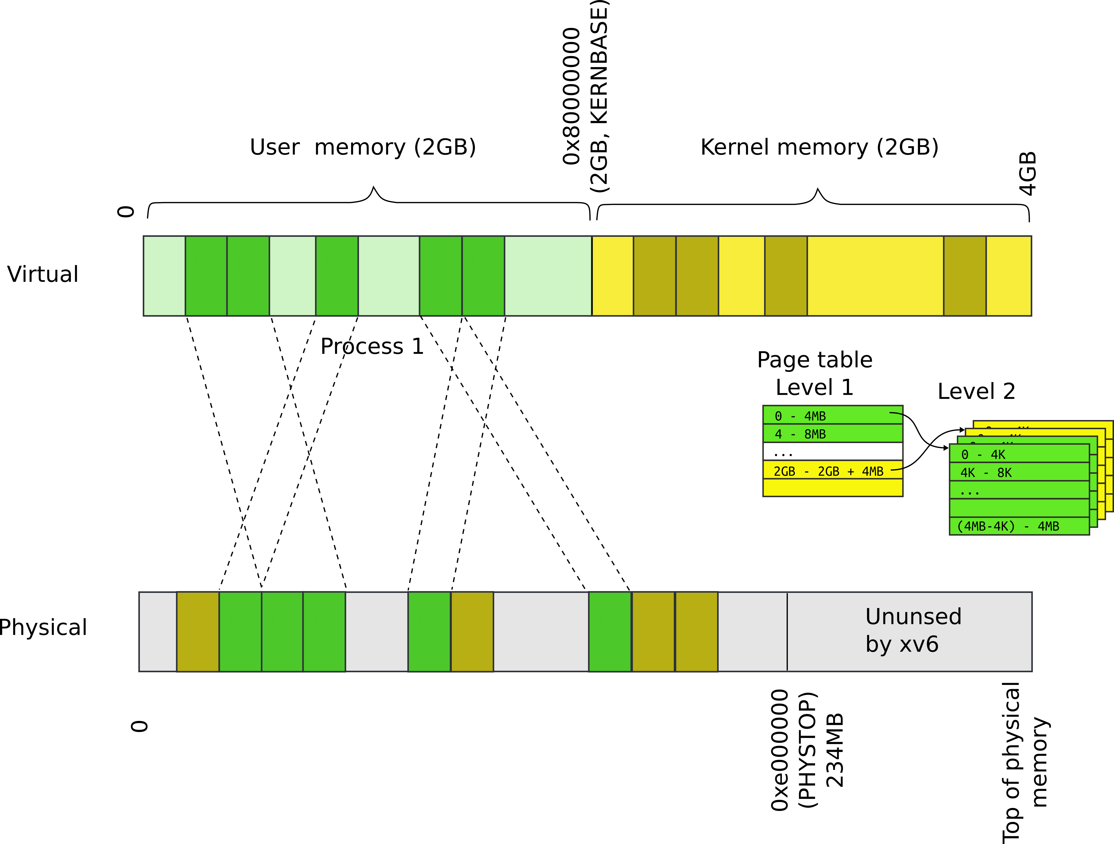
Recap: Can a process overwrite kernel memory?

Slide 23
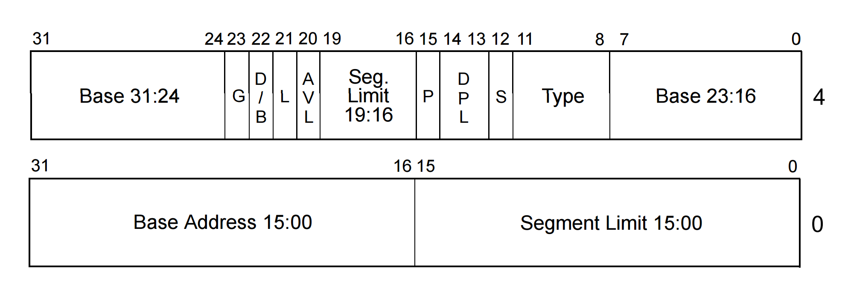
Privilege levels
Each segment has a privilege level
DPL (descriptor privilege level)
4 privilege levels ranging 0-3

Slide 24

WAT!

Slide 25
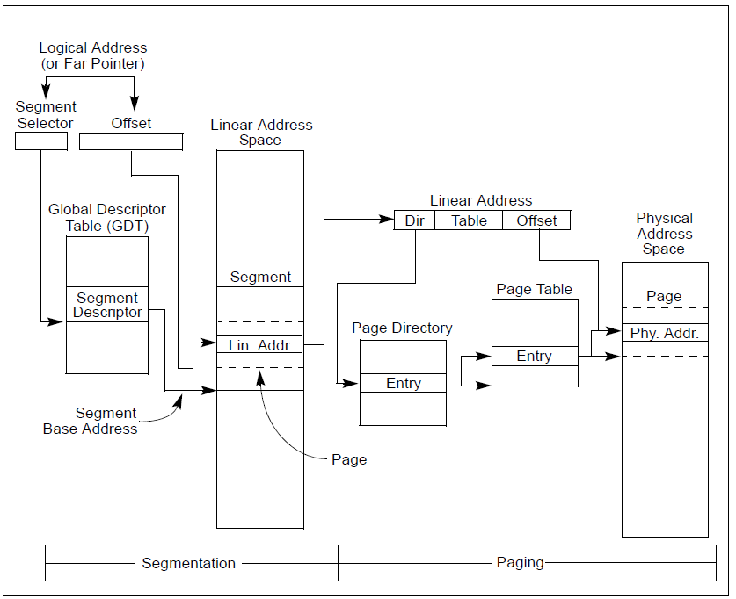

Slide 28
Privilege levels
Each segment has a privilege level
DPL (descriptor privilege level)
4 privilege levels ranging 0-3

Slide 29
Privilege levels
Currently running code also has a privilege level
“Current privilege level” (CPL): 0-3
It is saved in the %cs register
It was loaded there when the descriptor for the currently running code was loaded into %cs

Slide 30
Privilege level transitions
CPL can access only less privileged segments
E.g., 0 can access 0, 1, 2, 3
1 can access 1, 2, 3
3 can access 3
Some instructions are “privileged”
Can only be invoked at CPL = 0
Examples:
Load GDT
MOV <control register>
E.g. reload a page table by changing CR3

Slide 31
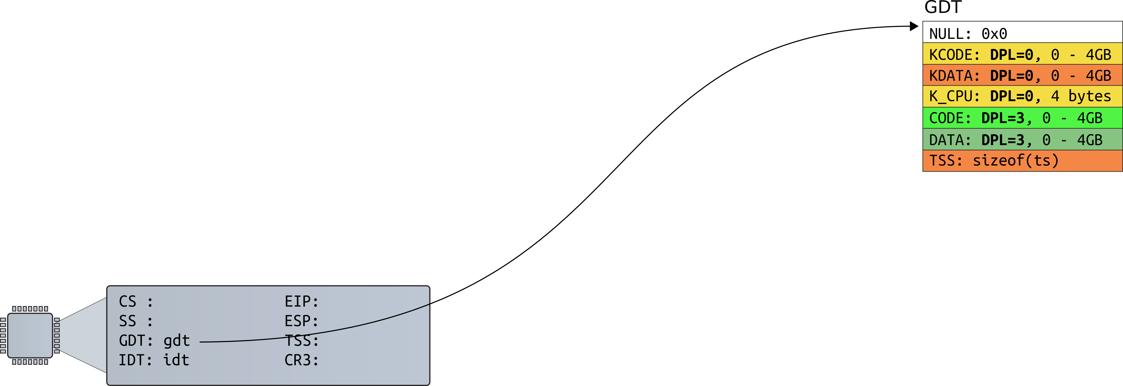
Xv6 example: started boot (no CPL yet)

Slide 32
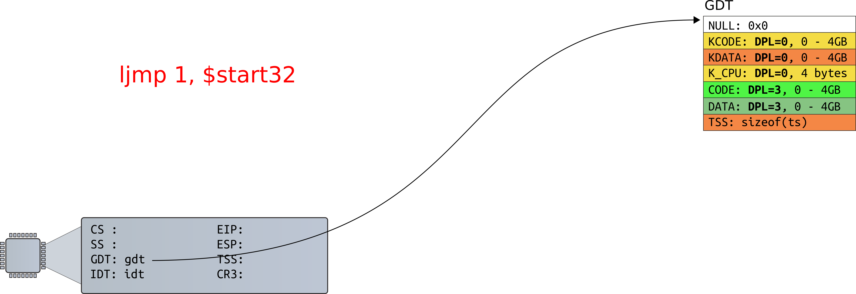
Xv6 example: prepare to load GDT entry #1

Slide 33
Privilege levels
Each segment has a privilege level
DPL (descriptor privilege level)
4 privilege levels ranging 0-3

Slide 34
How GDT is defined
9180 # Bootstrap GDT
9181 .p2align 2 # force 4 byte alignment
9182 gdt:
9183 SEG_NULLASM # null seg
9184 SEG_ASM(STA_X|STA_R, 0x0, 0xffffffff) # code seg
9185 SEG_ASM(STA_W, 0x0, 0xffffffff) # data seg
9186
9187 gdtdesc:
9188 .word (gdtdesc − gdt − 1) # sizeof(gdt) − 1
9189 .long gdt

Slide 35
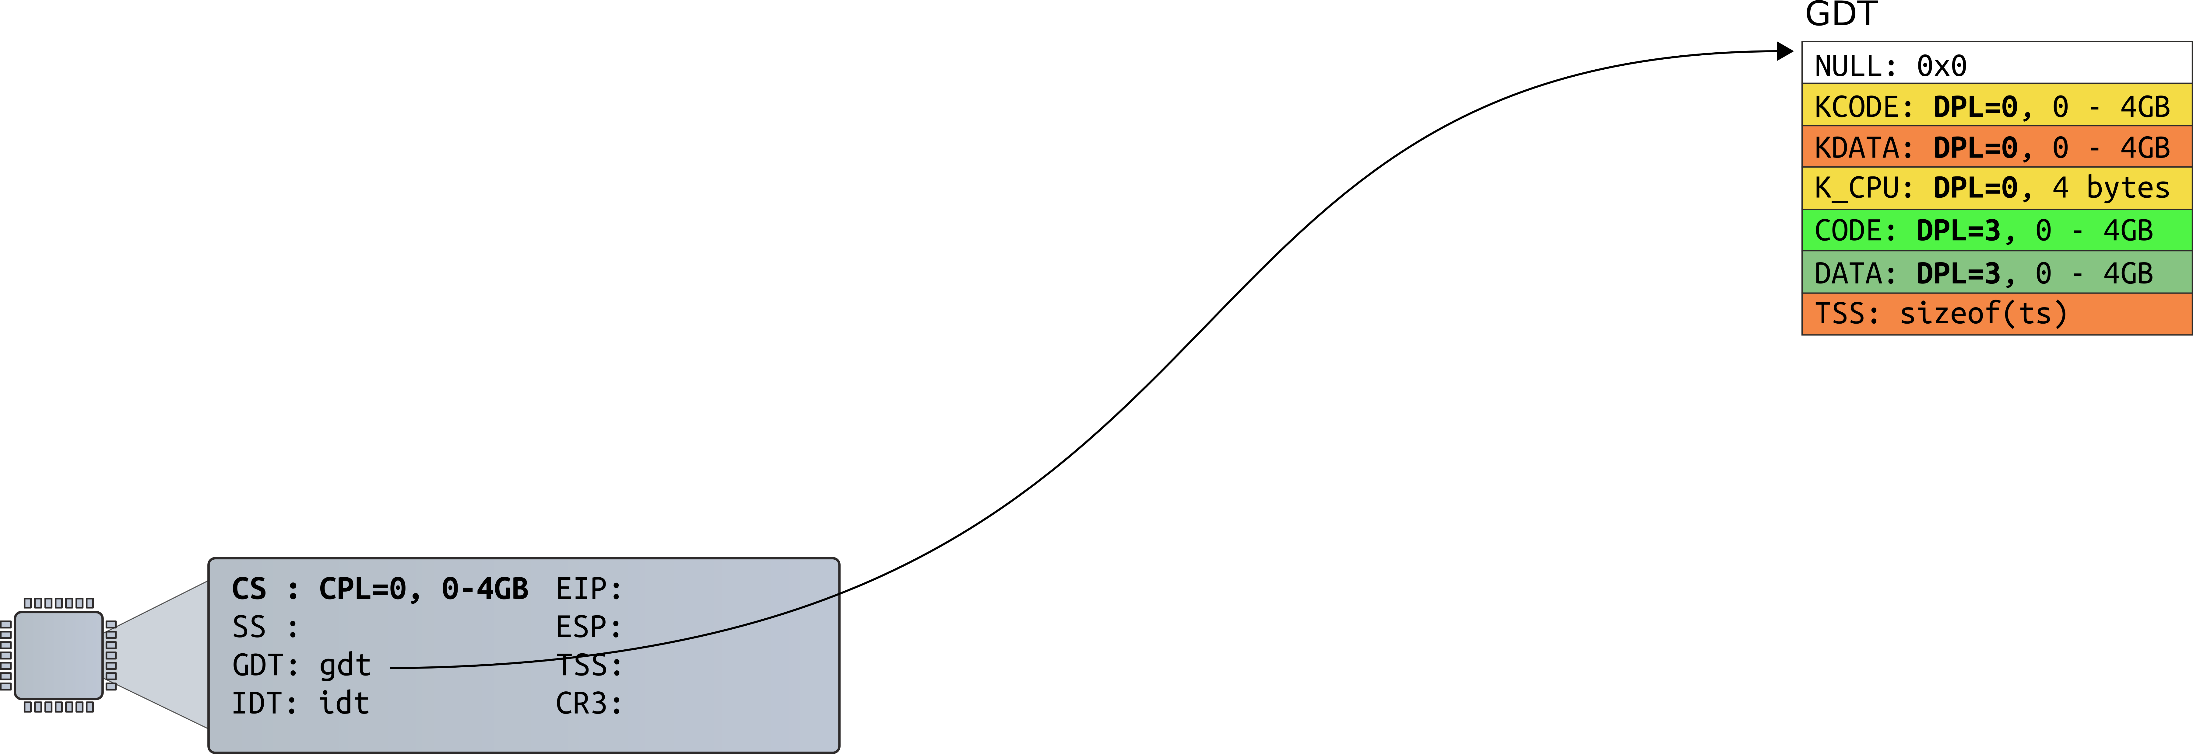
Now CPL=0. We run in the kernel

Slide 36
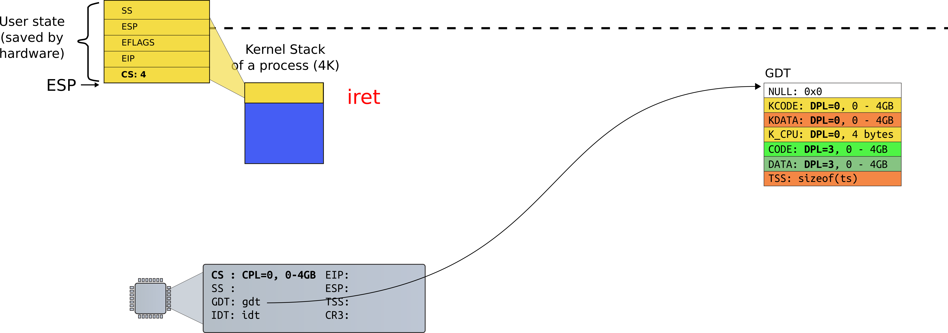
iret: return to user, load GDT #4

Slide 37
Run in user, CPL=3

Slide 38
Real world
Only two privilege levels are used in modern OSes:
OS kernel runs at 0
User code runs at 3
This is called “flat” segment model
Segments for both 0 and 3 cover entire address space

Slide 39
How GDT is initialized in xv6?

Slide 40
1317 main(void)
1318 {
1319 kinit1(end, P2V(4*1024*1024)); // phys page allocator
1320 kvmalloc(); // kernel page table
1321 mpinit(); // detect other processors
1322 lapicinit(); // interrupt controller
1323 seginit(); // segment descriptors
1324 cprintf("\ncpu%d: starting xv6\n\n", cpunum());
1325 picinit(); // another interrupt controller
1326 ioapicinit(); // another interrupt controller
1327 consoleinit(); // console hardware
1328 uartinit(); // serial port
1329 pinit(); // process table
1330 tvinit(); // trap vectors
1331 binit(); // buffer cache
1332 fileinit(); // file table
1333 ideinit(); // disk
1334 if(!ismp)
1335 timerinit(); // uniprocessor timer
1336 startothers(); // start other processors
1337 kinit2(P2V(4*1024*1024), P2V(PHYSTOP)); // must come after startothers()
1338 userinit(); // first user process
1339 mpmain(); // finish this processor’s setup
1340 }
main()

Slide 41
Initialize GDT
1712 // Set up CPU’s kernel segment descriptors.
1713 // Run once on entry on each CPU.
1714 void
1715 seginit(void)
1716 {
1717 struct cpu *c;
1718
1719 // Map "logical" addresses to virtual addresses using identity map.
1720 // Cannot share a CODE descriptor for both kernel and user
1721 // because it would have to have DPL_USR, but the CPU forbids
1722 // an interrupt from CPL=0 to DPL=3.
1723 c = &cpus[cpuid()];
1724 c−>gdt[SEG_KCODE] = SEG(STA_X|STA_R, 0, 0xffffffff, 0);
1725 c−>gdt[SEG_KDATA] = SEG(STA_W, 0, 0xffffffff, 0);
1726 c−>gdt[SEG_UCODE] = SEG(STA_X|STA_R, 0, 0xffffffff, DPL_USER);
1727 c−>gdt[SEG_UDATA] = SEG(STA_W, 0, 0xffffffff, DPL_USER);
1728 lgdt(c−>gdt, sizeof(c−>gdt));
1729 }
main()
seginit()

Slide 42
Struct CPU
2300 // Per−CPU state
2301 struct cpu {
2302 uchar apicid; // Local APIC ID
2303 struct context *scheduler; // swtch() here to enter scheduler
2304 struct taskstate ts; // Used by x86 to find stack for interrupt
2305 struct segdesc gdt[NSEGS]; // x86 global descriptor table
2306 volatile uint started; // Has the CPU started?
2307 int ncli; // Depth of pushcli nesting.
2308 int intena; // Were interrupts enabled before pushcli?
2309 struct proc *proc; // The process running on this cpu or null
2310 };
2311
2312 extern struct cpu cpus[NCPU];

Slide 43
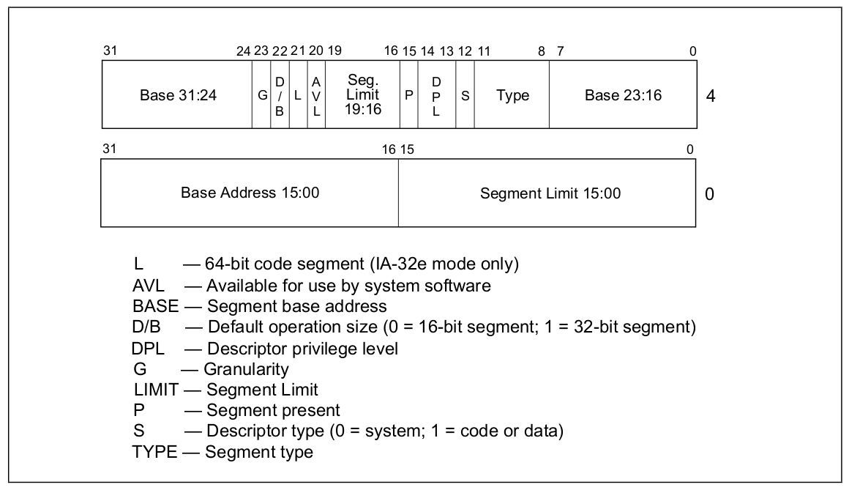
Segment descriptor

Slide 44
Segment Descriptor
0724 // Segment Descriptor
0725 struct segdesc {
0726 uint lim_15_0 : 16; // Low bits of segment limit
0727 uint base_15_0 : 16; // Low bits of segment base address
0728 uint base_23_16 : 8; // Middle bits of segment base address
0729 uint type : 4; // Segment type (see STS_ constants)
0730 uint s : 1; // 0 = system, 1 = application
0731 uint dpl : 2; // Descriptor Privilege Level
0732 uint p : 1; // Present
0733 uint lim_19_16 : 4; // High bits of segment limit
0734 uint avl : 1; // Unused (available for software use)
0735 uint rsv1 : 1; // Reserved
0736 uint db : 1; // 0 = 16−bit segment, 1 = 32−bit segment
0737 uint g : 1; // Granularity: limit scaled by 4K when set
0738 uint base_31_24 : 8; // High bits of segment base address
0739 };

Slide 45
Real world
Only two privilege levels are used in modern OSes:
OS kernel runs at 0
User code runs at 3
This is called “flat” segment model
Segments for both 0 and 3 cover entire address space
But then... how the kernel is protected?

Slide 46
Real world
Only two privilege levels are used in modern OSes:
OS kernel runs at 0
User code runs at 3
This is called “flat” segment model
Segments for both 0 and 3 cover entire address space
But then... how the kernel is protected?
Page tables

Slide 47
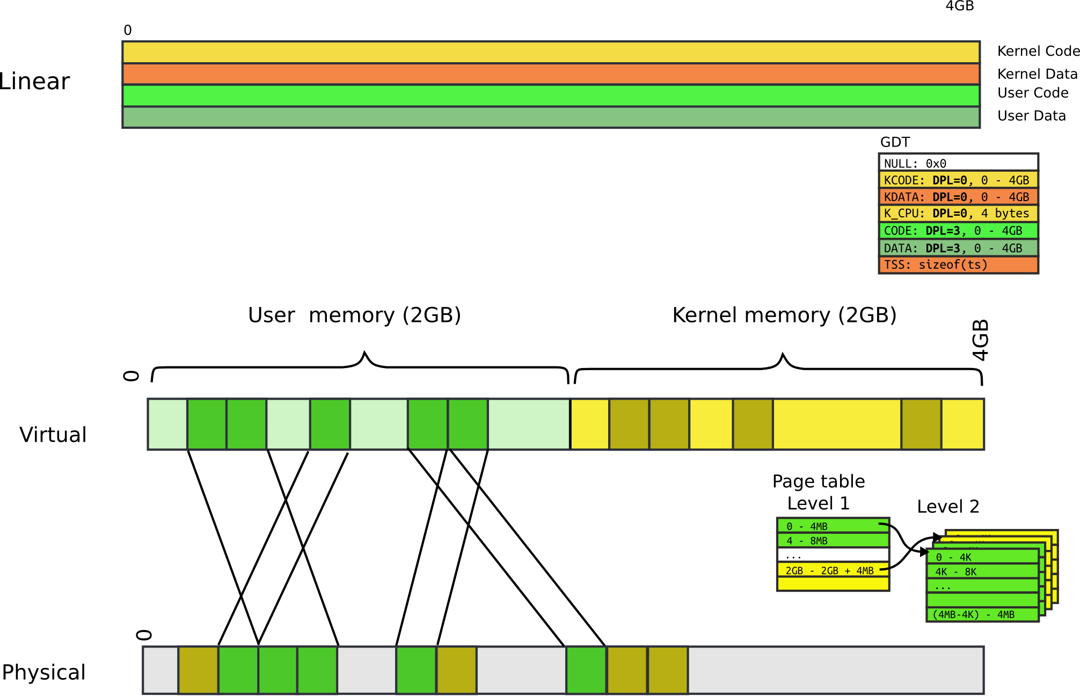

Slide 48
Page table: user bit
Each entry (both Level 1 and Level 2) has a bit
If set, code at privilege level 3 can access
If not, only levels 0-2 can access
Note, only 2 levels, not 4 like with segments
All kernel code is mapped with the user bit clear
This protects user-level code from accessing the kernel

Slide 49
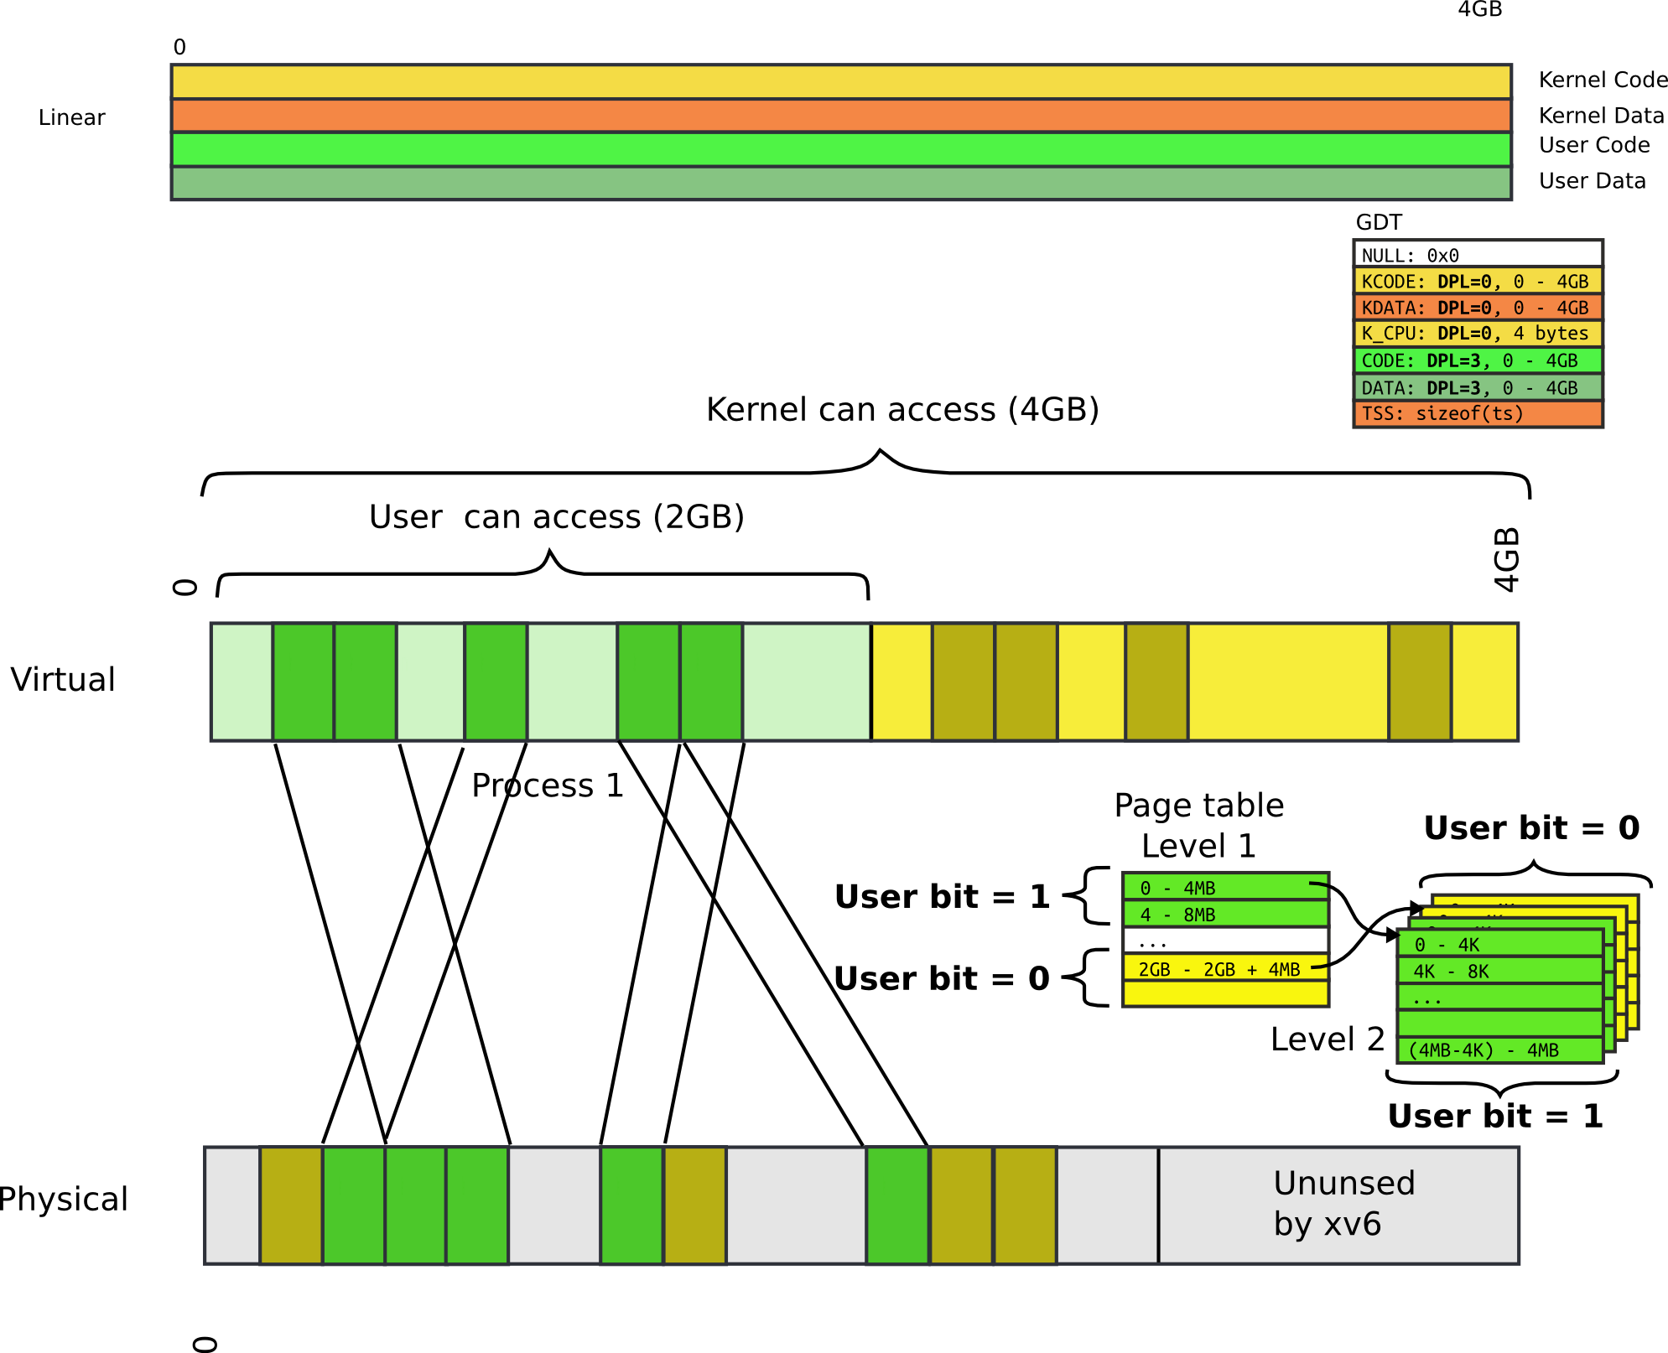

Slide 50
End of detour:
Back to handling interrupts

Slide 51
Processing of an interrupt when change of a privilege level is required

Slide 52
Processing of interrupt (cross PL)
Assume we're at CPL =3 (user)

Slide 53
Interrupt descriptor (an entry in the IDT)
Interrupt is allowed if...
current privilege level (CPL) is less or equal to descriptor privilege level (DPL)
The kernel protects device interrupts from user

Slide 54
Interrupt descriptor (an entry in the IDT)
Note that this new segment can be more privileged
E.g., CPL = 3, DPL = 3, new segment can be PL = 0
This is how user-code (PL=3) transitions into kernel (PL=0)

Slide 55
Interrupt path

Slide 56
Stack
Can we continue on the same stack?

Slide 57
Stack
But how the hardware knows where it is?

Slide 58
TSS: Task State Segment (yet another table)

Slide 59
Task State Segment
Another magic control block
Pointed to by special task register (TR)
Lots of fields for rarely-used features
A feature we care about in a modern OS:
Location of kernel stack (fields SS/ESP)
Stack segment selector
Location of the stack in that segment

Slide 60
Processing of interrupt (cross PL)
Save ESP and SS in a CPU-internal register
Load SS and ESP from TSS
Push user SS, user ESP, user EFLAGS, user CS, user EIP onto new stack (kernel stack)
Set CS and EIP from IDT descriptor's segment selector and offset
If the call is through an interrupt gate clear interrupts enabled EFLAGS bit
Begin execution of a handler

Slide 61
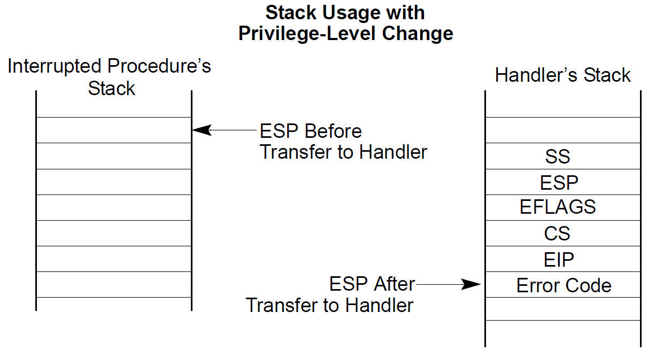

Slide 63
Complete interrupt path

Slide 64
Interrupt descriptor table (IDT)

Slide 66
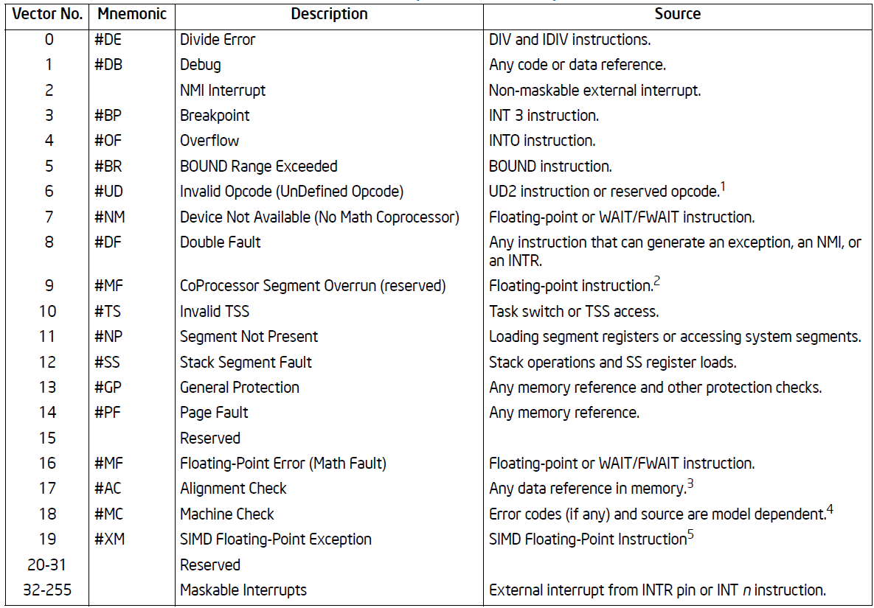

Slide 68
Interrupts
Each type of interrupt is assigned an index from 0—255.
0—31 are for processor interrupts fixed by Intel
E.g., 14 is always for page faults
32—255 are software configured
32—47 are often used for device interrupts (IRQs)
Most device IRQ lines can be configured
Look up APICs for more info (Ch 4 of Bovet and Cesati)
0x80 issues system call in Linux
Xv6 uses 0x40 (64) for the system call

Slide 69
Disabling interrupts
Delivery of interrupts can be disabled with IF (interrupt flag) in EFLAGS register
There is a couple of exceptions
Synchronous interrupts cannot be disabled
It doesn't make sense to disable a page fault
INT n – cannot be masked as it is synchronous
Non-maskable interrupts (see next slide)
Interrupt #2 in the IDT

Slide 71
Nonmaskable interrupts (NMI)
Delivered even if IF is clear, e.g. interrupts disabled
CPU blocks subsequent NMI interrupts until IRET
Sources
External hardware asserts the NMI pin
Processor receives a message on the system bus, or the APIC serial bus with NMI delivery mode
Delivered via vector #2

Slide 72
Xv6 source

Slide 73
1317 main(void)
1318 {
1319 kinit1(end, P2V(4*1024*1024)); // phys page allocator
1320 kvmalloc(); // kernel page table
1321 mpinit(); // detect other processors
1322 lapicinit(); // interrupt controller
1323 seginit(); // segment descriptors
1324 cprintf("\ncpu%d: starting xv6\n\n", cpunum());
1325 picinit(); // another interrupt controller
1326 ioapicinit(); // another interrupt controller
1327 consoleinit(); // console hardware
1328 uartinit(); // serial port
1329 pinit(); // process table
1330 tvinit(); // trap vectors
1331 binit(); // buffer cache
1332 fileinit(); // file table
1333 ideinit(); // disk
1334 if(!ismp)
1335 timerinit(); // uniprocessor timer
1336 startothers(); // start other processors
1337 kinit2(P2V(4*1024*1024), P2V(PHYSTOP)); // must come after startothers()
1338 userinit(); // first user process
1339 mpmain(); // finish this processor’s setup
1340 }
main()

Slide 74
Initialize IDT
3316 void
3317 tvinit(void)
3318 {
3319 int i;
3320
3321 for(i = 0; i < 256; i++)
3322 SETGATE(idt[i], 0, SEG_KCODE<<3, vectors[i], 0);
3323 SETGATE(idt[T_SYSCALL], 1, SEG_KCODE<<3,
vectors[T_SYSCALL], DPL_USER);
3324
3325 initlock(&tickslock, "time");
3326 }
tvinit() is called from main()
main()
tvinit()

Slide 75
Initialize IDT
3316 void
3317 tvinit(void)
3318 {
3319 int i;
3320
3321 for(i = 0; i < 256; i++)
3322 SETGATE(idt[i], 0, SEG_KCODE<<3, vectors[i], 0);
3323 SETGATE(idt[T_SYSCALL], 1, SEG_KCODE<<3,
vectors[T_SYSCALL], DPL_USER);
3324
3325 initlock(&tickslock, "time");
3326 }
System call interrupt vector (T_SYSCALL)
main()
tvinit()

Slide 76
Protection
Generally user code cannot invoke int X
i.e., can't issue int 14 (a page fault)
OS configures the IDT in such a manner that invocation of all int X instructions besides 0x40 triggers a general protection fault exception
Interrupt vector 13

Slide 77
Remember this slide: interrupt descriptor (an entry in the IDT)
Interrupt is allowed if...
current privilege level (CPL) is less or equal to descriptor privilege level (DPL)
The kernel protects device interrupts from user

Slide 78
Initialize IDT
3316 void
3317 tvinit(void)
3318 {
3319 int i;
3320
3321 for(i = 0; i < 256; i++)
3322 SETGATE(idt[i], 0, SEG_KCODE<<3, vectors[i], 0);
3323 SETGATE(idt[T_SYSCALL], 1, SEG_KCODE<<3,
vectors[T_SYSCALL], DPL_USER);
3324
3325 initlock(&tickslock, "time");
3326 }
A couple of important details
main()
tvinit()

Slide 79
Initialize IDT
3316 void
3317 tvinit(void)
3318 {
3319 int i;
3320
3321 for(i = 0; i < 256; i++)
3322 SETGATE(idt[i], 0, SEG_KCODE<<3, vectors[i], 0);
3323 SETGATE(idt[T_SYSCALL], 1, SEG_KCODE<<3,
vectors[T_SYSCALL], DPL_USER);
3324
3325 initlock(&tickslock, "time");
3326 }
Only int T_SYSCALL can be called from user-level
main()
tvinit()

Slide 80
Initialize IDT
3316 void
3317 tvinit(void)
3318 {
3319 int i;
3320
3321 for(i = 0; i < 256; i++)
3322 SETGATE(idt[i], 0, SEG_KCODE<<3, vectors[i], 0);
3323 SETGATE(idt[T_SYSCALL], 1, SEG_KCODE<<3,
vectors[T_SYSCALL], DPL_USER);
3324
3325 initlock(&tickslock, "time");
3326 }
Syscall is a “trap”
i.e., doesn't disable interrupts
main()
tvinit()

Slide 81
Interrupt path through the xv6 kernel

Slide 82
Complete interrupt path

Slide 83
Timer Interrupt (int 0x32)
vector32:
pushl $0 // error code
pushl $32 // vector #
jmp alltraps
int 0x32
vector32
Automatically generated
From vectors.pl
vector.S

Slide 84
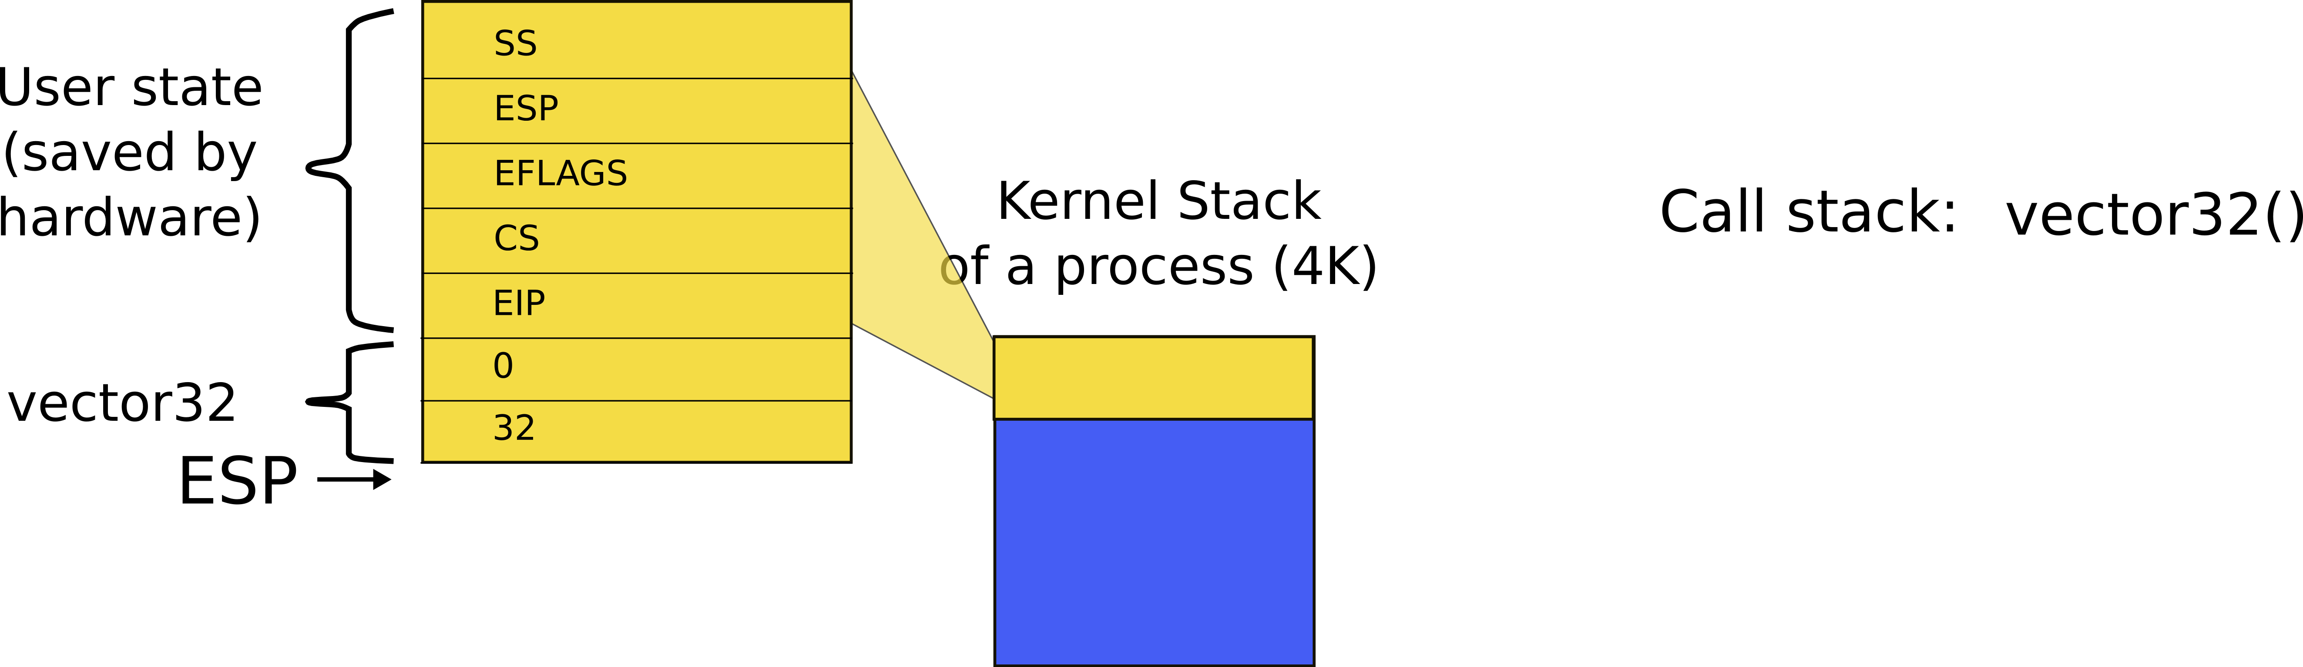
Kernel stack after interrupt
int 0x32
vector32

Slide 85
alltraps()
3254 alltraps:
3255 # Build trap frame.
3256 pushl %ds
3257 pushl %es
3258 pushl %fs
3259 pushl %gs
3260 pushal
3261
3262 # Set up data segments.
3263 movw $(SEG_KDATA<<3), %ax
3264 movw %ax, %ds
3265 movw %ax, %es
3266
3267 # Call trap(tf), where tf=%esp
3268 pushl %esp
3269 call trap
int 0x64
vector64
alltraps

Slide 86
pusha
An assembler instruction that saves all registers on the stack
https://c9x.me/x86/html/file_module_x86_id_270.html
Temporary = ESP;
Push(EAX);
Push(ECX);
Push(EDX);
Push(EBX);
Push(Temporary);
Push(EBP);
Push(ESI);
Push(EDI);

Slide 87
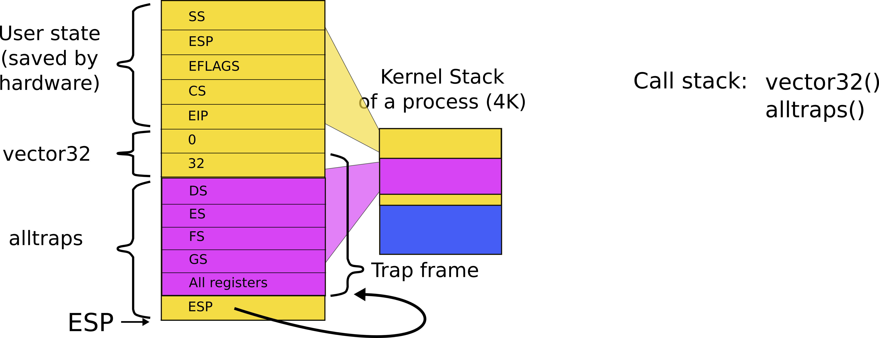
Kernel stack after interrupt
int 0x32
vector32
alltraps

Slide 88
The end result: call trap()
3254 alltraps:
3255 # Build trap frame.
3256 pushl %ds
3257 pushl %es
3258 pushl %fs
3259 pushl %gs
3260 pushal
3261
3262 # Set up data and per−cpu segments.
3263 movw $(SEG_KDATA<<3), %ax
3264 movw %ax, %ds
3265 movw %ax, %es
3266 movw $(SEG_KCPU<<3), %ax
3267 movw %ax, %fs
3268 movw %ax, %gs
3269
3270 # Call trap(tf), where tf=%esp
3271 pushl %esp
3272 call trap
int 0x32
vector32
alltraps

Slide 89
All interrupts, e.g. timer interrupt end up in a single funciton: trap()
3351 trap(struct trapframe *tf)
3352 {
...
3363 switch(tf−>trapno){
3364 case T_IRQ0 + IRQ_TIMER:
3365 if(cpu−>id == 0){
3366 acquire(&tickslock);
3367 ticks++;
3368 wakeup(&ticks);
3369 release(&tickslock);
3370 }
3372 break;
...
3423 if(proc && proc−>state == RUNNING
&& tf−>trapno == T_IRQ0+IRQ_TIMER)
3424 yield();
int 0x32
vector32
alltraps
trap(*tf)

Slide 90
alltraps(): exit from the interrupt
3004 alltraps:
...
3020 # Call trap(tf), where tf=%esp
3021 pushl %esp
3022 call trap
3023 addl $4, %esp
3024
3025 # Return falls through to trapret...
3026 .globl trapret
3027 trapret:
3028 popal
3029 popl %gs
3030 popl %fs
3031 popl %es
3032 popl %ds
3033 addl $0x8, %esp # trapno and errcode
3034 iret

Slide 91
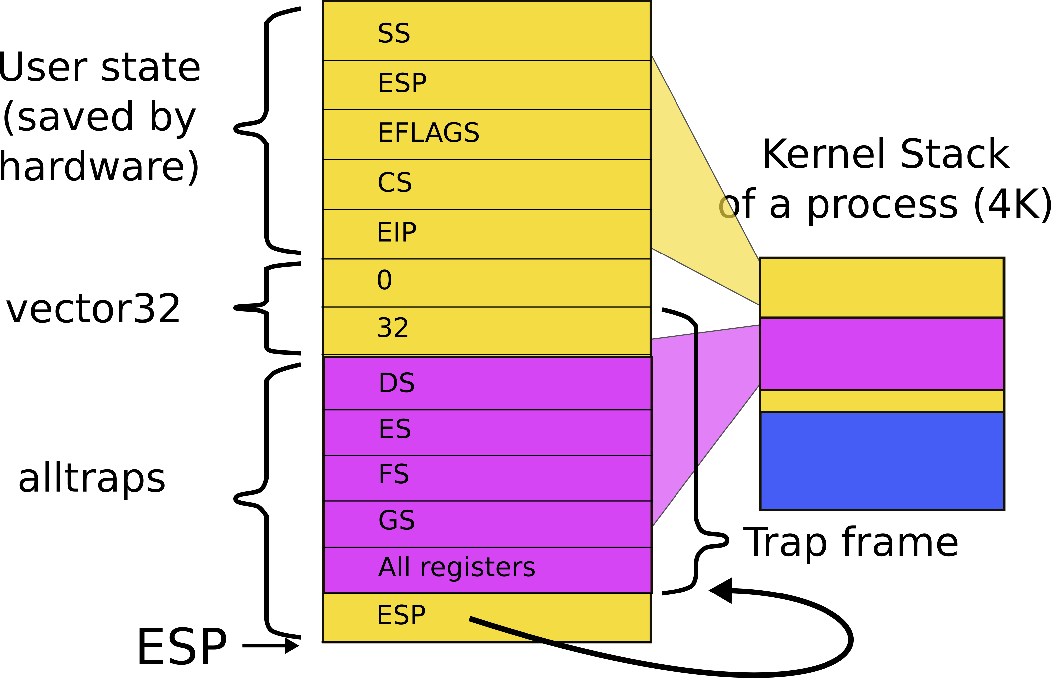
Stack after trap() returns

Slide 92
alltraps(): exiting
3004 alltraps:
...
3020 # Call trap(tf), where tf=%esp
3021 pushl %esp
3022 call trap
3023 addl $4, %esp
3024
3025 # Return falls through to trapret...
3026 .globl trapret
3027 trapret:
3028 popal
3029 popl %gs
3030 popl %fs
3031 popl %es
3032 popl %ds
3033 addl $0x8, %esp # trapno and errcode
3034 iret
Restore all registers
Exit into user
iret

Slide 93
Return from an interrupt
Starts with IRET
Restore the CS and EIP registers to their values prior to the interrupt or exception
Restore EFLAGS
Restore SS and ESP to their values prior to interrupt
This results in a stack switch
Resume execution of interrupted procedure

Slide 94
We're back to where we were when timer interrupt was raised

Slide 95
System Calls
(int 0x40)

Slide 96
Software interrupts can be used to implement system calls
The int N instruction provides a secure mechanism for kernel invocation
i.e., user can enter the kernel
But through a well-defined entry point
System call handler
Xv6 uses vector 0x40 (or 64)
You can choose any other unused vector
Linux uses 0x80
Well now it uses sysenter instead of int 0x80 as it is faster

Slide 97
System call path

Slide 98
Where does IDT (entry 64) point to?
vector64:
pushl $0 // error code
pushl $64 // vector #
jmp alltraps
int 0x64
vector64
Automatically generated
From vectors.pl
vector.S

Slide 99
Kernel stack inside system call
int 0x64
vector64

Slide 100
alltraps()
3254 alltraps:
3255 # Build trap frame.
3256 pushl %ds
3257 pushl %es
3258 pushl %fs
3259 pushl %gs
3260 pushal
3261
3262 # Set up data and per−cpu segments.
3263 movw $(SEG_KDATA<<3), %ax
3264 movw %ax, %ds
3265 movw %ax, %es
3266 movw $(SEG_KCPU<<3), %ax
3267 movw %ax, %fs
3268 movw %ax, %gs
3269
3270 # Call trap(tf), where tf=%esp
3271 pushl %esp
3272 call trap
int 0x64
vector64
alltraps

Slide 101
Kernel stack inside system call
int 0x32
vector32
alltraps

Slide 102
System call handling inside trap()
3351 trap(struct trapframe *tf)
3352 {
3353 if(tf−>trapno == T_SYSCALL){
3354 if(proc−>killed)
3355 exit();
3356 proc−>tf = tf;
3357 syscall();
3358 if(proc−>killed)
3359 exit();
3360 return;
3361 }
3362
3363 switch(tf−>trapno){
3364 case T_IRQ0 + IRQ_TIMER:
int 0x64
vector64
alltraps
trap(*tf)

Slide 103
Syscall number
System call number is passed in the %eax register
To distinguish which syscall to invoke,
e.g., sys_read, sys_exec, etc.
alltrap() saves it along with all other registers

Slide 104
syscall(): get the number from the trap frame
3625 syscall(void)
3626 {
3627 int num;
3628
3629 num = proc−>tf−>eax;
3630 if(num > 0 && num < NELEM(syscalls) && syscalls[num]) {
3631 proc−>tf−>eax = syscalls[num]();
3632 } else {
3633 cprintf("%d %s: unknown sys call %d\n",
3634 proc−>pid, proc−>name, num);
3635 proc−>tf−>eax = −1;
3636 }
3637 }
int 0x64
vector64
alltraps
trap(*tf)
syscall()

Slide 105
syscall(): process a syscall from the table
3625 syscall(void)
3626 {
3627 int num;
3628
3629 num = proc−>tf−>eax;
3630 if(num > 0 && num < NELEM(syscalls) && syscalls[num]) {
3631 proc−>tf−>eax = syscalls[num]();
3632 } else {
3633 cprintf("%d %s: unknown sys call %d\n",
3634 proc−>pid, proc−>name, num);
3635 proc−>tf−>eax = −1;
3636 }
3637 }

Slide 106
System call table
3600 static int (*syscalls[])(void) = {
3601 [SYS_fork] sys_fork,
3602 [SYS_exit] sys_exit,
3603 [SYS_wait] sys_wait,
3604 [SYS_pipe] sys_pipe,
3605 [SYS_read] sys_read,
3606 [SYS_kill] sys_kill,
3607 [SYS_exec] sys_exec,
3608 [SYS_fstat] sys_fstat,
3609 [SYS_chdir] sys_chdir,
3610 [SYS_dup] sys_dup,
3611 [SYS_getpid] sys_getpid,
3612 [SYS_sbrk] sys_sbrk,
3613 [SYS_sleep] sys_sleep,
3614 [SYS_uptime] sys_uptime,
3615 [SYS_open] sys_open,
3616 [SYS_write] sys_write,
3617 [SYS_mknod] sys_mknod,
3618 [SYS_unlink] sys_unlink,
3619 [SYS_link] sys_link,
3620 [SYS_mkdir] sys_mkdir,
3621 [SYS_close] sys_close,
3622 };

Slide 107
How do user programs access system calls?
It would be weird to write
8410 pushl $argv
8411 pushl $init
8412 pushl $0 // where caller pc would be
8413 movl $SYS_exec, %eax
8414 int $T_SYSCALL
… every time we want to invoke a system call
This is an example for the exec() system call

Slide 108
// system calls
int fork(void);
int exit(void) __attribute__((noreturn));
int wait(void);
int pipe(int*);
int write(int, void*, int);
int read(int, void*, int);
int close(int);
int kill(int);
int exec(char*, char**);
int open(char*, int);
int mknod(char*, short, short);
int unlink(char*);
int fstat(int fd, struct stat*);
int link(char*, char*);
...
user.h
user.h defines system call prototypes
Compiler can generate correct system call stacks
Remember calling conventions?
Arguments on the stack

Slide 109
Example
From cat.asm
if (write(1, buf, n) != n)
A3: 53 push ebx
a4: 68 00 0b 00 00 push 0xb00
a9: 6a 01 push 0x1
ab: e8 c2 02 00 00 call 372 <write>

Slide 110
Note, different versions of gcc
and different optimization levels
Will generate slightly different code

Slide 111
Example
From cat.asm
if (write(1, buf, n) != n)
a0: 89 5c 24 08 mov %ebx,0x8(%esp)
a4: c7 44 24 04 00 0b 00 movl $0xb00,0x4(%esp)
ab: 00
ac: c7 04 24 01 00 00 00 movl $0x1,(%esp)
b3: e8 aa 02 00 00 call 362 <write>

Slide 112
Example
From cat.asm
if (write(1, buf, n) != n)
a0: 89 5c 24 08 mov %ebx,0x8(%esp)
a4: c7 44 24 04 00 0b 00 movl $0xb00,0x4(%esp)
ab: 00
ac: c7 04 24 01 00 00 00 movl $0x1,(%esp)
b3: e8 aa 02 00 00 call 362 <write>

Slide 113
Example
From cat.asm
if (write(1, buf, n) != n)
a0: 89 5c 24 08 mov %ebx,0x8(%esp)
a4: c7 44 24 04 00 0b 00 movl $0xb00,0x4(%esp)
ab: 00
ac: c7 04 24 01 00 00 00 movl $0x1,(%esp)
b3: e8 aa 02 00 00 call 362 <write>

Slide 114
Still not clear...
The header file allows compiler to generate a call side invocation,
e.g., push arguments on the stack
But where is the system call invocation itself
e.g., int $T_SYSCALL

Slide 115
8450 #include "syscall.h"
8451 #include "traps.h"
8452
8453 #define SYSCALL(name) \
8454 .globl name; \
8455 name: \
8456 movl $SYS_ ## name, %eax; \
8457 int $T_SYSCALL; \
8458 ret
8459
8460 SYSCALL(fork)
8461 SYSCALL(exit)
8462 SYSCALL(wait)
8463 SYSCALL(pipe)
8464 SYSCALL(read)
usys.S
Xv6 uses a SYSCALL macro to define a function for each system call invocation
E.g., fork() to invoke the “fork” system call

Slide 116
Example
Write system call from cat.asm
00000362 <write>:
SYSCALL(write)
362: b8 10 00 00 00 mov $0x10,%eax
367: cd 40 int $0x40
369: c3 ret

Slide 117
System call arguments
Where are the system call arguments?
How does kernel access them?
And returns results?

Slide 118
Example
Write system call
if (write(1, buf, n) != n)
5876 int
5877 sys_write(void)
5878 {
5879 struct file *f;
5880 int n;
5881 char *p;
5882
5883 if(argfd(0, 0, &f) < 0 || argint(2, &n) < 0 || argptr(1, &p, n) < 0)
5884 return −1;
5885 return filewrite(f, p, n);
5886 }

Slide 119
Example
Write system call
if (write(1, buf, n) != n)
5876 int
5877 sys_write(void)
5878 {
5879 struct file *f;
5880 int n;
5881 char *p;
5882
5883 if(argfd(0, 0, &f) < 0 || argint(2, &n) < 0 || argptr(1, &p, n) < 0)
5884 return −1;
5885 return filewrite(f, p, n);
5886 }

Slide 120
argint(int n, int *ip)
3543 // Fetch the nth 32−bit system call argument.
3544 int
3545 argint(int n, int *ip)
3546 {
3547 return fetchint(proc−>tf−>esp + 4 + 4*n, ip);
3548 }
3515 // Fetch the int at addr from the current process.
3516 int
3517 fetchint(uint addr, int *ip)
3518 {
3519 if(addr >= proc−>sz || addr+4 > proc−>sz)
3520 return −1;
3521 *ip = *(int*)(addr);
3522 return 0;
3523 }

Slide 121
argint(int n, int *ip)
3543 // Fetch the nth 32−bit system call argument.
3544 int
3545 argint(int n, int *ip)
3546 {
3547 return fetchint(proc−>tf−>esp + 4 + 4*n, ip);
3548 }
3515 // Fetch the int at addr from the current process.
3516 int
3517 fetchint(uint addr, int *ip)
3518 {
3519 if(addr >= proc−>sz || addr+4 > proc−>sz)
3520 return −1;
3521 *ip = *(int*)(addr);
3522 return 0;
3523 }

Slide 122
argint(int n, int *ip)
3543 // Fetch the nth 32−bit system call argument.
3544 int
3545 argint(int n, int *ip)
3546 {
3547 return fetchint(proc−>tf−>esp + 4 + 4*n, ip);
3548 }
3515 // Fetch the int at addr from the current process.
3516 int
3517 fetchint(uint addr, int *ip)
3518 {
3519 if(addr >= proc−>sz || addr+4 > proc−>sz)
3520 return −1;
3521 *ip = *(int*)(addr);
3522 return 0;
3523 }
Start with the address where current user stack is (esp)

Slide 123
argint(int n, int *ip)
3543 // Fetch the nth 32−bit system call argument.
3544 int
3545 argint(int n, int *ip)
3546 {
3547 return fetchint(proc−>tf−>esp + 4 + 4*n, ip);
3548 }
3515 // Fetch the int at addr from the current process.
3516 int
3517 fetchint(uint addr, int *ip)
3518 {
3519 if(addr >= proc−>sz || addr+4 > proc−>sz)
3520 return −1;
3521 *ip = *(int*)(addr);
3522 return 0;
3523 }
Skip return eip

Slide 124
argint(int n, int *ip)
3543 // Fetch the nth 32−bit system call argument.
3544 int
3545 argint(int n, int *ip)
3546 {
3547 return fetchint(proc−>tf−>esp + 4 + 4*n, ip);
3548 }
3515 // Fetch the int at addr from the current process.
3516 int
3517 fetchint(uint addr, int *ip)
3518 {
3519 if(addr >= proc−>sz || addr+4 > proc−>sz)
3520 return −1;
3521 *ip = *(int*)(addr);
3522 return 0;
3523 }
Fetch n'th argument

Slide 125
fetchint(uint addr, int *ip)
3543 // Fetch the nth 32−bit system call argument.
3544 int
3545 argint(int n, int *ip)
3546 {
3547 return fetchint(proc−>tf−>esp + 4 + 4*n, ip);
3548 }
3515 // Fetch the int at addr from the current process.
3516 int
3517 fetchint(uint addr, int *ip)
3518 {
3519 if(addr >= proc−>sz || addr+4 > proc−>sz)
3520 return −1;
3521 *ip = *(int*)(addr);
3522 return 0;
3523 }

Slide 126
fetchint(uint addr, int *ip)
3543 // Fetch the nth 32−bit system call argument.
3544 int
3545 argint(int n, int *ip)
3546 {
3547 return fetchint(proc−>tf−>esp + 4 + 4*n, ip);
3548 }
3515 // Fetch the int at addr from the current process.
3516 int
3517 fetchint(uint addr, int *ip)
3518 {
3519 if(addr >= proc−>sz || addr+4 > proc−>sz)
3520 return −1;
3521 *ip = *(int*)(addr);
3522 return 0;
3523 }

Slide 127
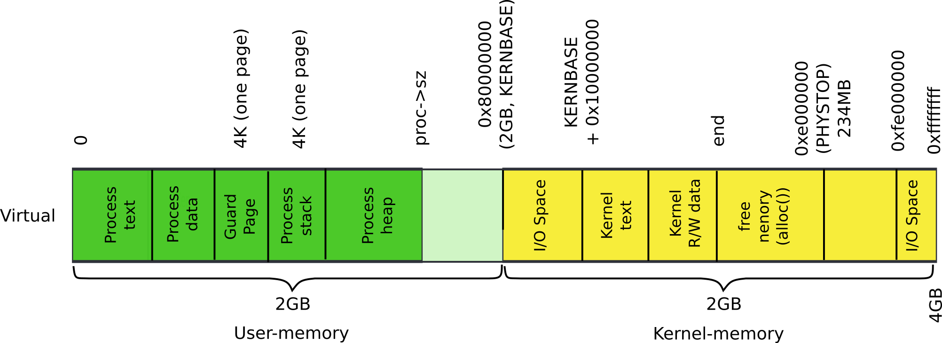
Process address space

Slide 128
Any idea for what argptr() shall do?
Write system call
if (write(1, buf, n) != n)
5876 int
5877 sys_write(void)
5878 {
5879 struct file *f;
5880 int n;
5881 char *p;
5882
5883 if(argfd(0, 0, &f) < 0 || argint(2, &n) < 0 || argptr(1, &p, n) < 0)
5884 return −1;
5885 return filewrite(f, p, n);
5886 }
Remember, buf is a pointer to a region of memory
i.e., a buffer
of size n

Slide 129
argptr(uint addr, int *ip)
3550 // Fetch the nth word−sized system call argument as a pointer
3551 // to a block of memory of size n bytes. Check that the pointer
3552 // lies within the process address space.
3553 int
3554 argptr(int n, char **pp, int size)
3555 {
3556 int i;
3557
3558 if(argint(n, &i) < 0)
3559 return −1;
3560 if((uint)i >= proc−>sz || (uint)i+size > proc−>sz)
3561 return −1;
3562 *pp = (char*)i;
3563 return 0;
3564 }
Check that the pointer to the buffer is sound

Slide 130
argptr(uint addr, int *ip)
3550 // Fetch the nth word−sized system call argument as a pointer
3551 // to a block of memory of size n bytes. Check that the pointer
3552 // lies within the process address space.
3553 int
3554 argptr(int n, char **pp, int size)
3555 {
3556 int i;
3557
3558 if(argint(n, &i) < 0)
3559 return −1;
3560 if((uint)i >= proc−>sz || (uint)i+size > proc−>sz)
3561 return −1;
3562 *pp = (char*)i;
3563 return 0;
3564 }
Check that the buffer is in user memory

Slide 131
Summary
We've learned how system calls work

Slide 132
Printing on the console

Slide 133
1317 main(void)
1318 {
1319 kinit1(end, P2V(4*1024*1024)); // phys page allocator
1320 kvmalloc(); // kernel page table
1321 mpinit(); // detect other processors
1322 lapicinit(); // interrupt controller
1323 seginit(); // segment descriptors
1324 cprintf("\ncpu%d: starting xv6\n\n", cpunum());
1325 picinit(); // another interrupt controller
1326 ioapicinit(); // another interrupt controller
1327 consoleinit(); // console hardware
1328 uartinit(); // serial port
1329 pinit(); // process table
1330 tvinit(); // trap vectors
1331 binit(); // buffer cache
1332 fileinit(); // file table
1333 ideinit(); // disk
1334 if(!ismp)
1335 timerinit(); // uniprocessor timer
1336 startothers(); // start other processors
1337 kinit2(P2V(4*1024*1024), P2V(PHYSTOP)); // must come after startothers()
1338 userinit(); // first user process
1339 mpmain(); // finish this processor’s setup
1340 }
main()

Slide 134
Print on the screen
8000 // Print to the console. only understands %d, %x, %p, %s.
8001 void
8002 cprintf(char *fmt, …)
8003 {
...
8012 if (fmt == 0)
8013 panic("null fmt");
8014
8015 argp = (uint*)(void*)(&fmt + 1);
8016 for(i = 0; (c = fmt[i] & 0xff) != 0; i++){
8017 if(c != ’%’){
8018 consputc(c);
8019 continue;
8020 }
8021 c = fmt[++i] & 0xff;
8022 if(c == 0)
8023 break;
8024 switch(c){
...
8032 case ’s’:
8033 if((s = (char*)*argp++) == 0)
8034 s = "(null)";
8035 for(; *s; s++)
8036 consputc(*s);
8037 break;
...
8047 }

Slide 135
Print one character
8150 void
8151 consputc(int c)
8152 {
...
8159 if(c == BACKSPACE){
8160 uartputc(’\b’); uartputc(’ ’); uartputc(’\b’);
8161 } else
8162 uartputc(c);
8163 cgaputc(c);
8164 }
...
8350 void
8351 uartputc(int c)
8352 {
8353 int i;
8354
8355 if(!uart)
8356 return;
8357 for(i = 0; i < 128 && !(inb(COM1+5) & 0x20); i++)
8358 microdelay(10);
8359 outb(COM1+0, c);
8360 }

Slide 136
1317 main(void)
1318 {
1319 kinit1(end, P2V(4*1024*1024)); // phys page allocator
1320 kvmalloc(); // kernel page table
1321 mpinit(); // detect other processors
1322 lapicinit(); // interrupt controller
1323 seginit(); // segment descriptors
1324 cprintf("\ncpu%d: starting xv6\n\n", cpunum());
1325 picinit(); // another interrupt controller
1326 ioapicinit(); // another interrupt controller
1327 consoleinit(); // console hardware
1328 uartinit(); // serial port
1329 pinit(); // process table
1330 tvinit(); // trap vectors
1331 binit(); // buffer cache
1332 fileinit(); // file table
1333 ideinit(); // disk
1334 if(!ismp)
1335 timerinit(); // uniprocessor timer
1336 startothers(); // start other processors
1337 kinit2(P2V(4*1024*1024), P2V(PHYSTOP)); // must come after startothers()
1338 userinit(); // first user process
1339 mpmain(); // finish this processor’s setup
1340 }
main()

Slide 137
Print on the screen
8000 // Print to the console. only understands %d, %x, %p, %s.
8001 void
8002 cprintf(char *fmt, …)
8003 {
...
8012 if (fmt == 0)
8013 panic("null fmt");
8014
8015 argp = (uint*)(void*)(&fmt + 1);
8016 for(i = 0; (c = fmt[i] & 0xff) != 0; i++){
8017 if(c != ’%’){
8018 consputc(c);
8019 continue;
8020 }
8021 c = fmt[++i] & 0xff;
8022 if(c == 0)
8023 break;
8024 switch(c){
...
8032 case ’s’:
8033 if((s = (char*)*argp++) == 0)
8034 s = "(null)";
8035 for(; *s; s++)
8036 consputc(*s);
8037 break;
...
8047 }

Slide 138
Print one character (serial line)
8150 void
8151 consputc(int c)
8152 {
...
8159 if(c == BACKSPACE){
8160 uartputc(’\b’); uartputc(’ ’); uartputc(’\b’);
8161 } else
8162 uartputc(c);
8163 cgaputc(c);
8164 }
...
8350 void
8351 uartputc(int c)
8352 {
8353 int i;
8354
8355 if(!uart)
8356 return;
8357 for(i = 0; i < 128 && !(inb(COM1+5) & 0x20); i++)
8358 microdelay(10);
8359 outb(COM1+0, c);
8360 }

Slide 139
Print one character (display)
8102 static ushort *crt = (ushort*)P2V(0xb8000); // CGA memory
8103
8104 static void
8105 cgaputc(int c)
8106 {
8107 int pos;
8108
...
8115 if(c == ’\n’)
8116 pos += 80 − pos%80;
8117 else if(c == BACKSPACE){
8118 if(pos > 0) −−pos;
8119 } else
8120 crt[pos++] = (c&0xff) | 0x0700; // black on white
8121
...
8124
8125 if((pos/80) >= 24){ // Scroll up.
8126 memmove(crt, crt+80, sizeof(crt[0])*23*80);
8127 pos −= 80;
8128 memset(crt+pos, 0, sizeof(crt[0])*(24*80 − pos));
8129 }
8130
...
8136 }

Slide 140
Thank you

